Slide 1

DISCO II Final Conference
“Describing Learning Outcomes and Skills Profiles.
European Terminologies of Skills and Competences”
«Application scenarios of DISCO I and II in the context of the ESCO»
ISFOL- ROME,
18th October 2012
Saverio Pescuma
Direzione Generale -
Servizio Programmazione
e Sviluppo

Slide 2





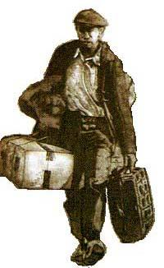
MOBILITY
With Europe 2020 the European Commision has identified mobility as one of the most important elements for economic growth and full employment in the EU countries.
Many tools have been made available in order to promote mobility (Europass, EQF, ECVET.........) DISCO & ESCO are both tools created to foster mobility
The first obstacle that a process of mobility have to face is languages. Both DISCO & ESCO intends to provide terminological support for European transparency tools.

Slide 3
SOURCE
DISCO is a content source for ESCO. Almost 100.000 terms and phrases available in 10 different languages offered by DISCO are a big store from which ESCO is gathering material
ESCO
Skills & Competences Pillar
DISCO TAXONOMY

Slide 4
DISCO for Information systems
Both DISCO and ESCO can't be considered as static Taxonomies. While we describe an occupation, we describe a social phenomenon, but social phenomenon change over time.
ESCO should envisage a mechanism that can keep its taxonomy updated over time
The same mechanism could be used as starting point for the work of the ESCO's experts groups
DISCO is a good starting point (not the only one!)

Slide 5
Let’s Build the tool (1) !
What should the system do?
We need a system that can keep definitions of occupations constantly updated
We need a very user friendly system that allows a EU citizen to insert her/his curriculum vitae/apply for a vacancy in her/his national system and instantly it can be read and evaluated in each of the European countries
On the other hand we need a system that allows a company to publish job ads in the system and, the job ads , can be read and applied for, instantly in each EU country
We need a system that can offer tools to compare and check for matches among thousands of curricula and vacancies in various languages
The system should be a meta-system that will integrates each country's systems/models without requiring their abandonment

Slide 6
Let’s Build the tool (2) !
What do we have?
A multilingual taxonomy (data base)
Internet (connectivity, computers etc..)
What do we need?
Data should be freely available: Linked Open Data (LOD)
An interoperability layer
A model of occupation that can be managed and elaborated by automatic systems
a software that can make this operations

Slide 7
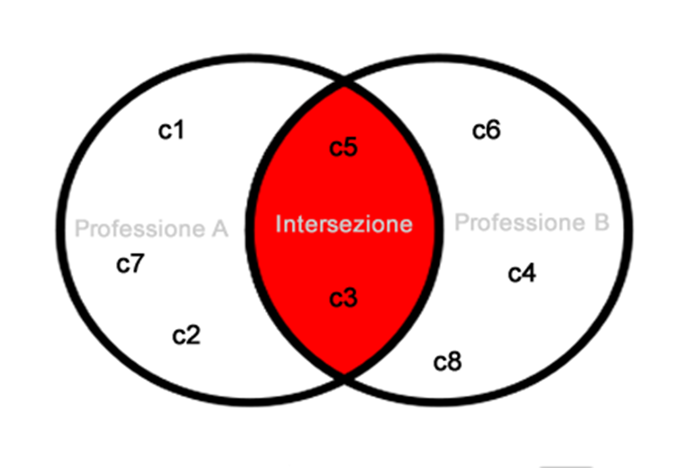
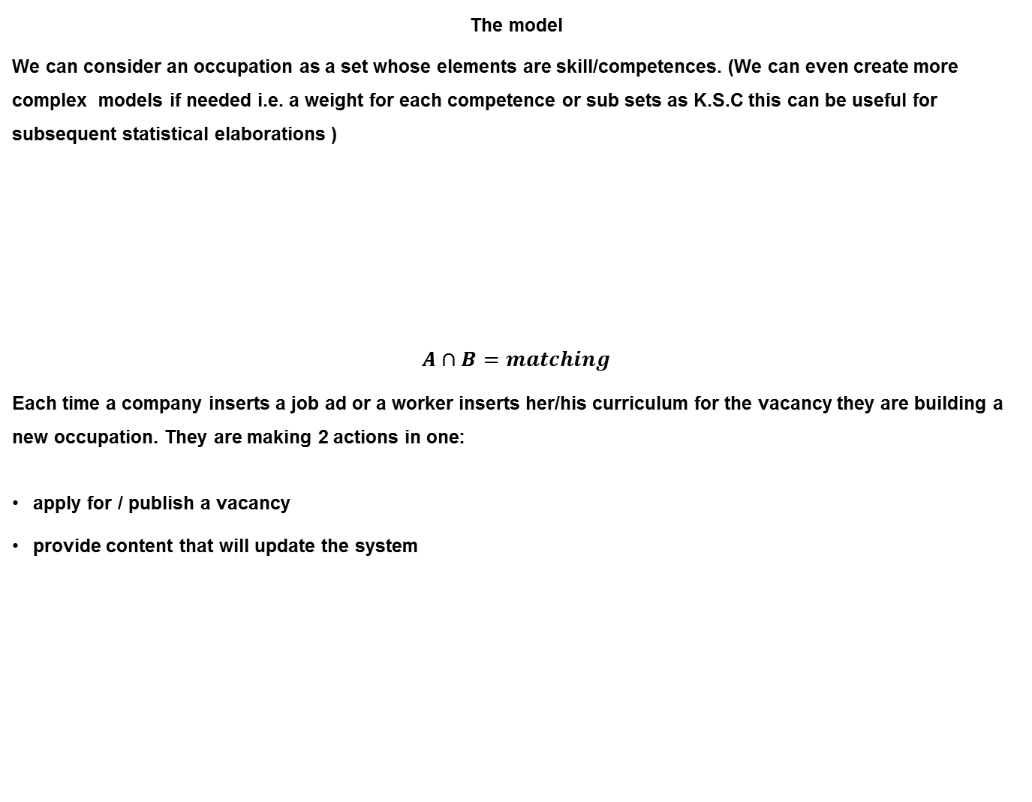
Let’s Build the tool: the model !
The model
We can consider an occupation as a set whose elements are skill/competences. (We can even create more complex models if needed i.e. a weight for each competence or sub sets as K.S.C this can be useful for subsequent statistical elaborations )
$$A∩B=matching$$
Each time a company inserts a job ad or a worker inserts her/his curriculum for the vacancy they are building a new occupation. They are making 2 actions in one:
apply for / publish a vacancy
provide content that will update the system

Slide 8
Let’s Build the tool: flow chart !
Login and start adding competences to your profile
Choose/Read items from database
Yes
Evaluated as ‘remarkable’
Is it present?
Manually insert it as added info
No
Yes
No
Add to your profile
Rejected
(will just appear as detail in your DISCO/ESCO Profile)

Slide 9

Let’s test it !
Now we are trying to test if it is possible to 'translate' the Item '3.4.2.4.1 - Tutor, istitutori e insegnanti nella formazione professionale' of the italian system with DISCO and……..
It is not possible to translate the terms!
So what about DISCO?

Slide 10

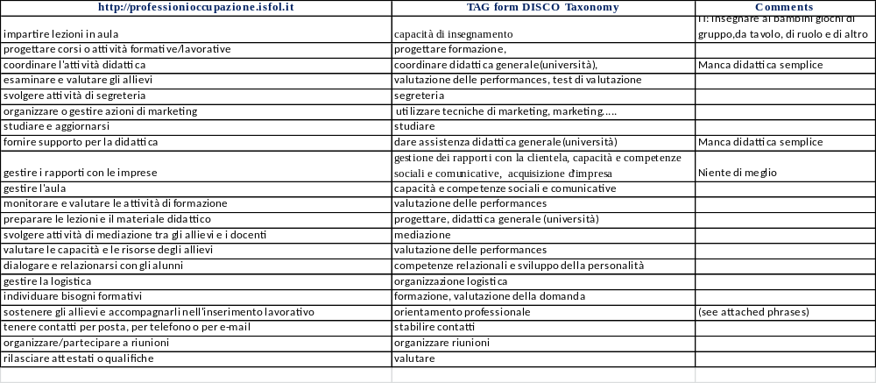
What about a tagging system?
Why don’t we try to use the DISCO items as tags/metadata (i.e Twitter)? Let’s try in thjs way!

Slide 11
And now let’s use it!
What we have to do now is to publish the content in some standard format (json here) and provide an URI!
diDISCO
mario_rossi{"capacità di insegnamento":"impartire lezioni in aula","progettare formazione":"progettare corsi o attività formative/lavorative","segreteria":"svolgere attività di segreteria"..........}
DISCO term
User definition
This part will provide an id for the matching process, you can search for ‘schopnost učit’ (CZ translation) and the system automatically
returns all the correspondences, in all available languages

Slide 12
And finally here we are!
it works (with some adjustment)!
DISCO
(ESCO) Profile
DISCO
(ESCO)
Repository
Foreign Employment System
DISCO
(ESCO)
Compliant
National Profile

Slide 13
Which problems do we have to solve?
Problems:
The list of competences and occupations should not be a static lists. It need to be constantly updated in order to ensure coverage of the all possible competences
Still too highly structured. Many words are present in DISCO inside a complete sentence and they can't be composed in other way
Need of standard syntactic rules to express complex sentences

Slide 14
SAVERIO PESCUMA
s.pescuma@isfol.it
Thank you for your attention!

